Slide 1
Chapter 13 – XML and JSON
CPSC 4620

Slide 2
Consider
When making a website we create HTML document
This document describes the structure of a web document (web page)
Specifies how things should appear on a screen
Uses several Tags
<Head> <Body> and so on
This system of using tags is called a Markup Language
A markup language specified code for formatting and presentation
What about the data that is sent to and from a web page?
Can we use a markup language for that?

Slide 3
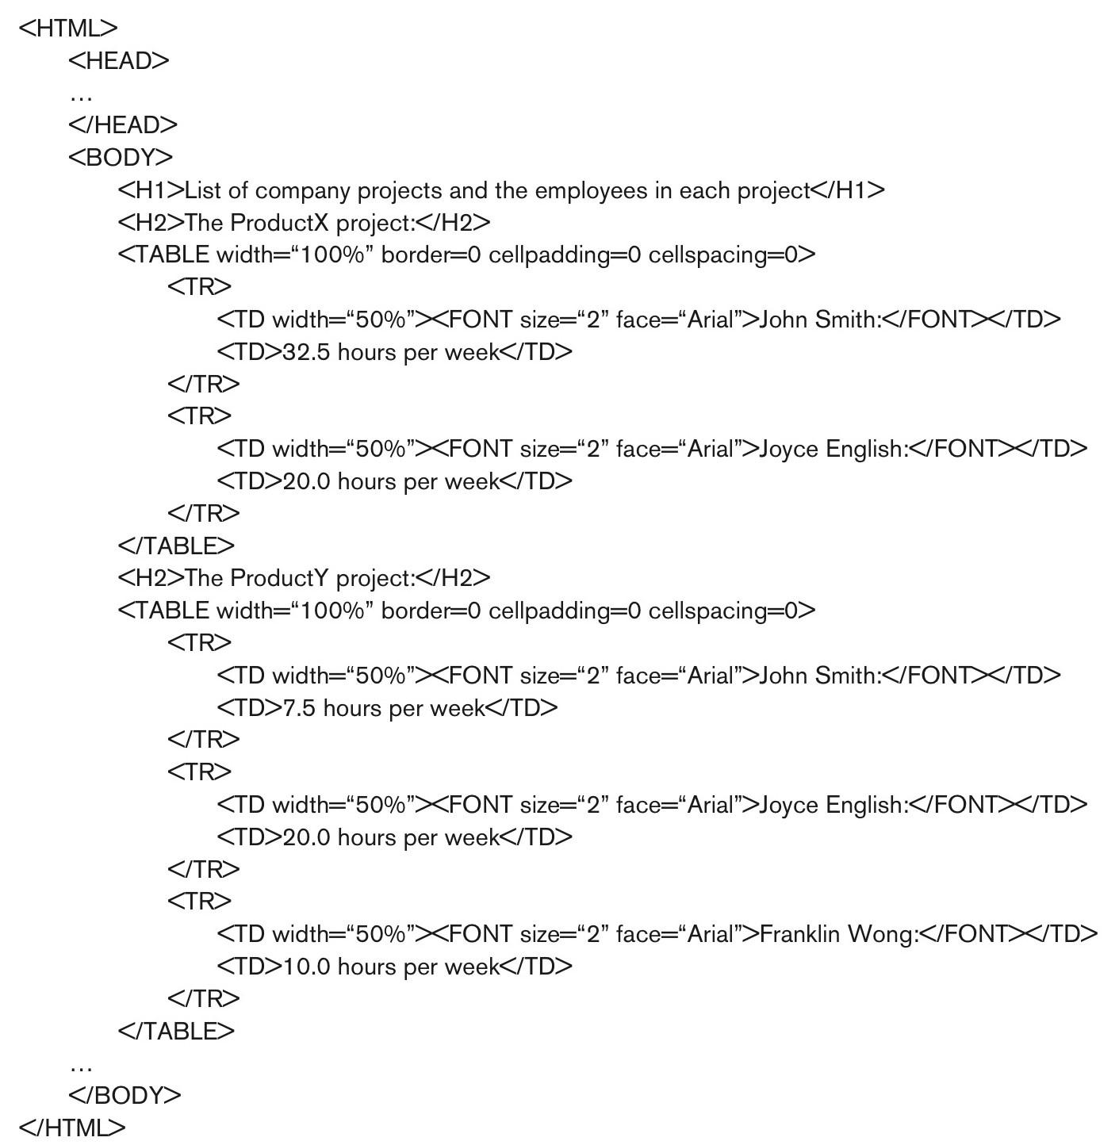
Figure 13.2 Part of an HTML document representing unstructured data.

Slide 4
XML
XML – eXtensible Markup Language
A markup language to describe the structure of data
As opposed to a document
Provides a description of the data using tags
Self-Describing document
Can be used for storage and retrieval
Mainly used for transferring data from one system to another
Remember, any collection of related data is a database

Slide 5
Structured, Semi-Structured, Unstructured
Structured Data – strict format
Relational DB – Every record in a table follows the same format
DBMS enforces the structure of a table
Semi-Structured Data – no pre-defined schema
Entities of the same type may have different attributes
New attributes can be introduced at any time
Structure is similar to a graph or tree
Schema is mixed with data
Unstructured data – no or limited indication of the type of data
Html pages have data in them, but they just all appear in between tags that specify formatting

Slide 6
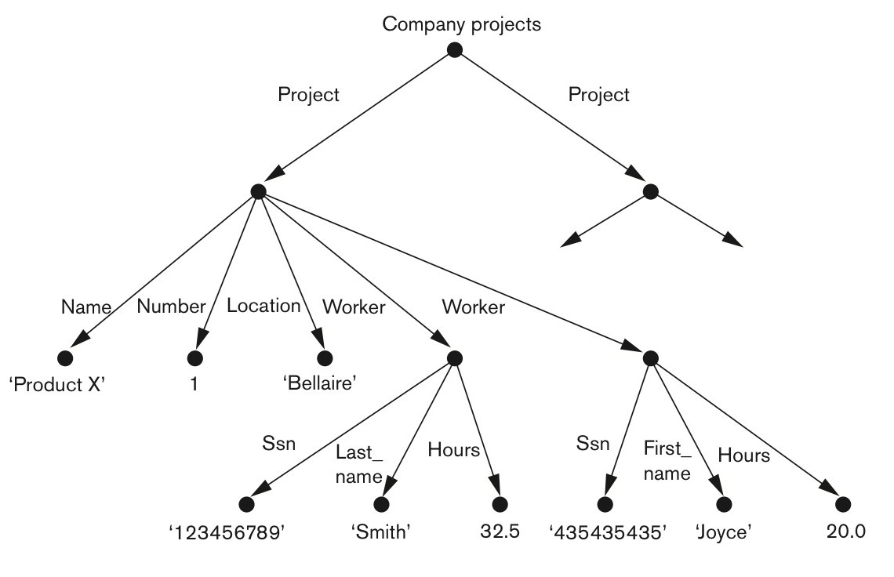
Figure 13.1 Representing semistructured data as a graph.

Slide 7
Hierarchical Model
The basic object in XML is the XML document
Constructed with elements and attributes
Elements
Identified with a start and end tag
<Project> … </Project>
Complex Elements are composed of other elements that appear between the tags
Simple Elements just have data values between their tags
Attributes
Not the same concept as a normal database or ER attribute
Used to help describe elements
Appear in the tag itself
Similar to attributes in html
Useful for metadata

Slide 8
Figure 13.1 Representing semistructured data as a graph.

Slide 9
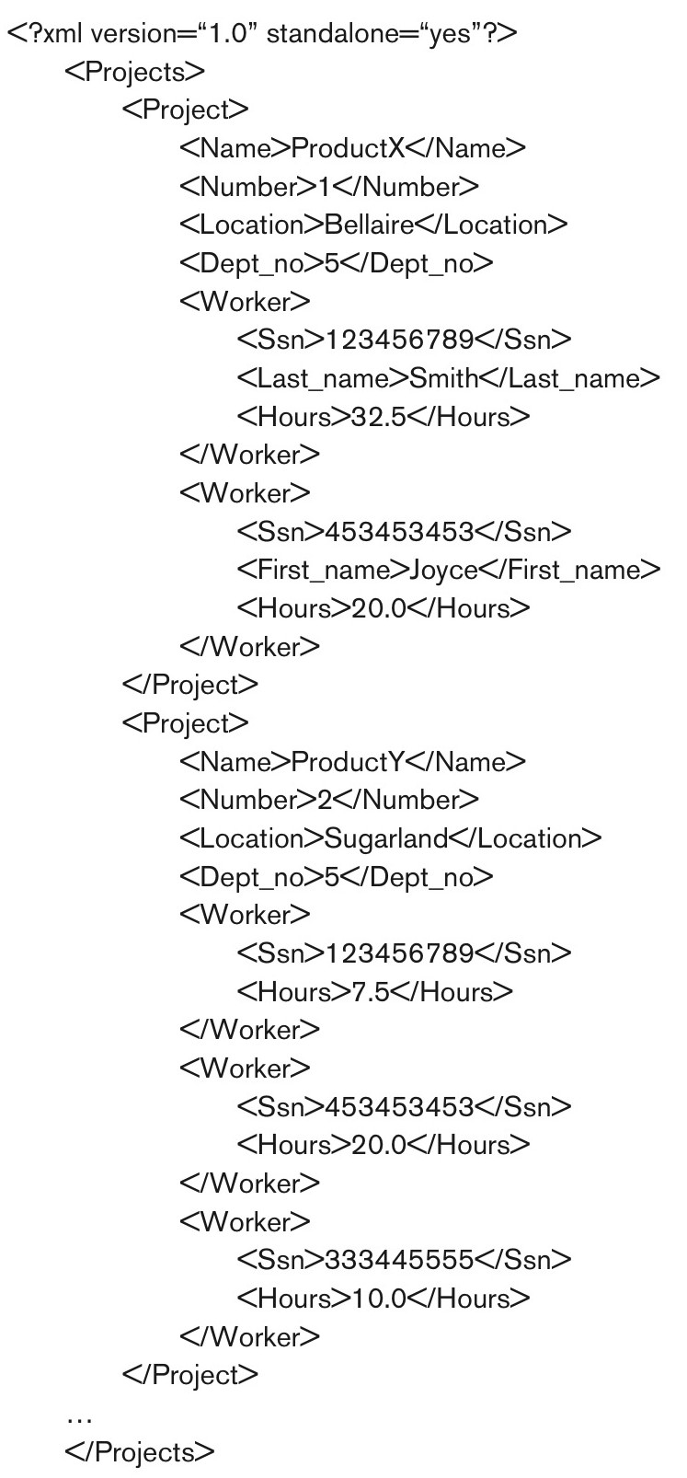
Figure 13.3 A complex XML element called <Projects>.

Slide 10
Parsing
Often we will define our own xml document structure to use with our applications
Use xml documents to transmit data
Can parse in our application
Example:
Client server calls function on application server to get data
Happens over a network, so not a direct function call
Application server sends query to data server through JDBC and gets data
Application server parses the ResultSet, but needs to send back across the network to client
Stores data in an xml document and transmits that
Client server parses xml document into local objects to use
Easy string parsing since the tags provide structure

Slide 11
Hierarchical model
Document is well formed if:
It starts with an XML declaration
It follows the tree data model
Has one single root/parent element
Every element has a pair of matching start and end tags
Every element appears within the start and end tags of the root element
A document is valid if:
It is well formed
It follows a particular schema

Slide 12
XML DTD
Document Type Definition
Specifies elements and the nested structure of our document
!DOCTYPE – specifies the name of our root element
<!DOCTYPE Projects [ …. ]>
!ELEMENT – Specifies and Element that may exist
(t1, t2, …) – specifies the data type(s) of the element
Can be another element
#PCDATA to be text
<!ELEMENT Project (Name, Number, Location)>
<!ELEMENT Name (#PCDATA)>
!ATTLIST – specifies any attributes of the element
<!ATTLIST Project ProjId ID #REQUIRED>

Slide 13
XML DTD
A * following the element name means the element can be repeated 0 or more times
A + following the element means it appears at least once, but can be more than once
A ? Following the element means it can appear once or not at all
Neither a *, a +, or a ? Means the element must appear exactly one time

Slide 14
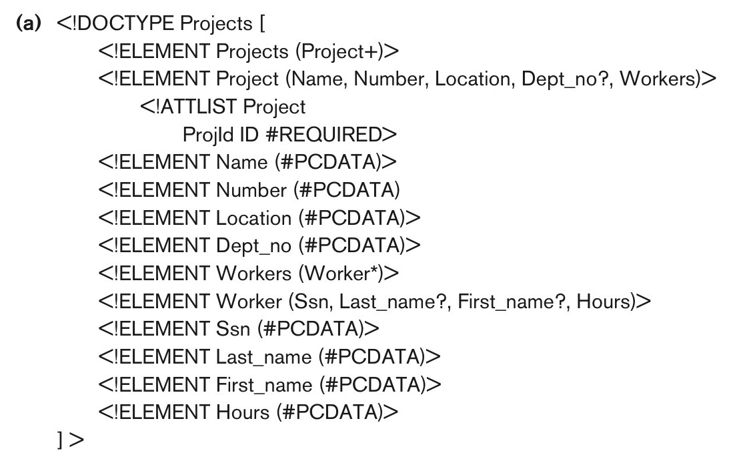
Figure 13.4a An XML DTD file called Projects.
continued on next slide

Slide 15
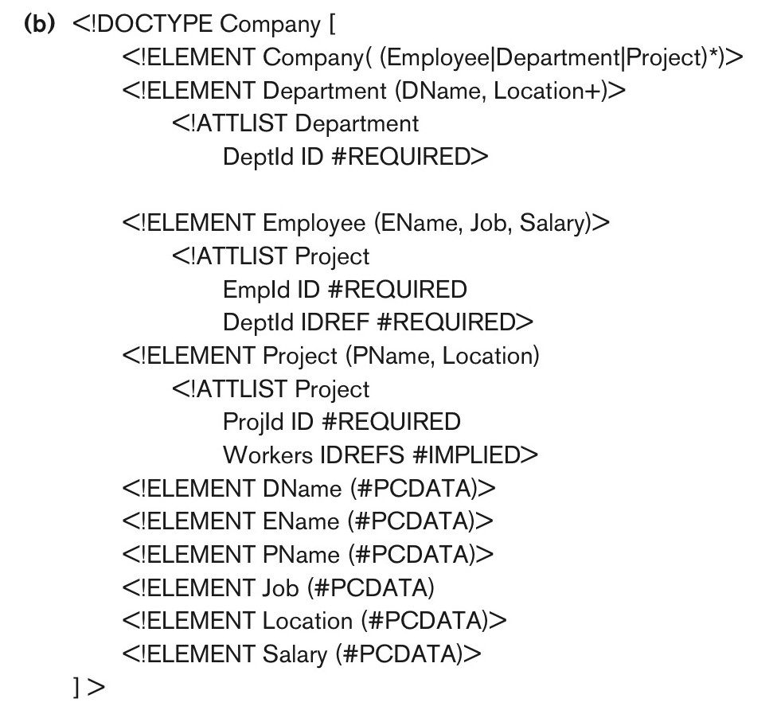
Figure 13.4b An XML DTD file called Company.

Slide 16
Enforcing XML DTD
If we want to require our XML document to follow a defined DTD
At the top of the document have:
<?xml version = “1.0”standalone = “no”?>
Standalone = no means it needs to be checked against a DTD or a schema
<!DOCTYPE Projects SYSTEM “proj.dtd”>
Says which DTD to use
Must be stored in the same directory or provide the path
Alternatively can put the DTD at the top of the document
Need an XML parser to check it
Built into IE, Dreamweaver and many others

Slide 17
Drawbacks of DTD
Has it’s own specialized syntax
Requires specialized parsers
Could we specify the syntax using xml syntax?
DTD requires a certain ordering of elements
Unordered elements not permitted

Slide 18
XML Schema
Uses XML syntax to specify the structure of XML documents
More general
Also more complex
Opens up to creating a whole Database Structure
Has keys, references and identifiers
We won’t go into the details

Slide 19
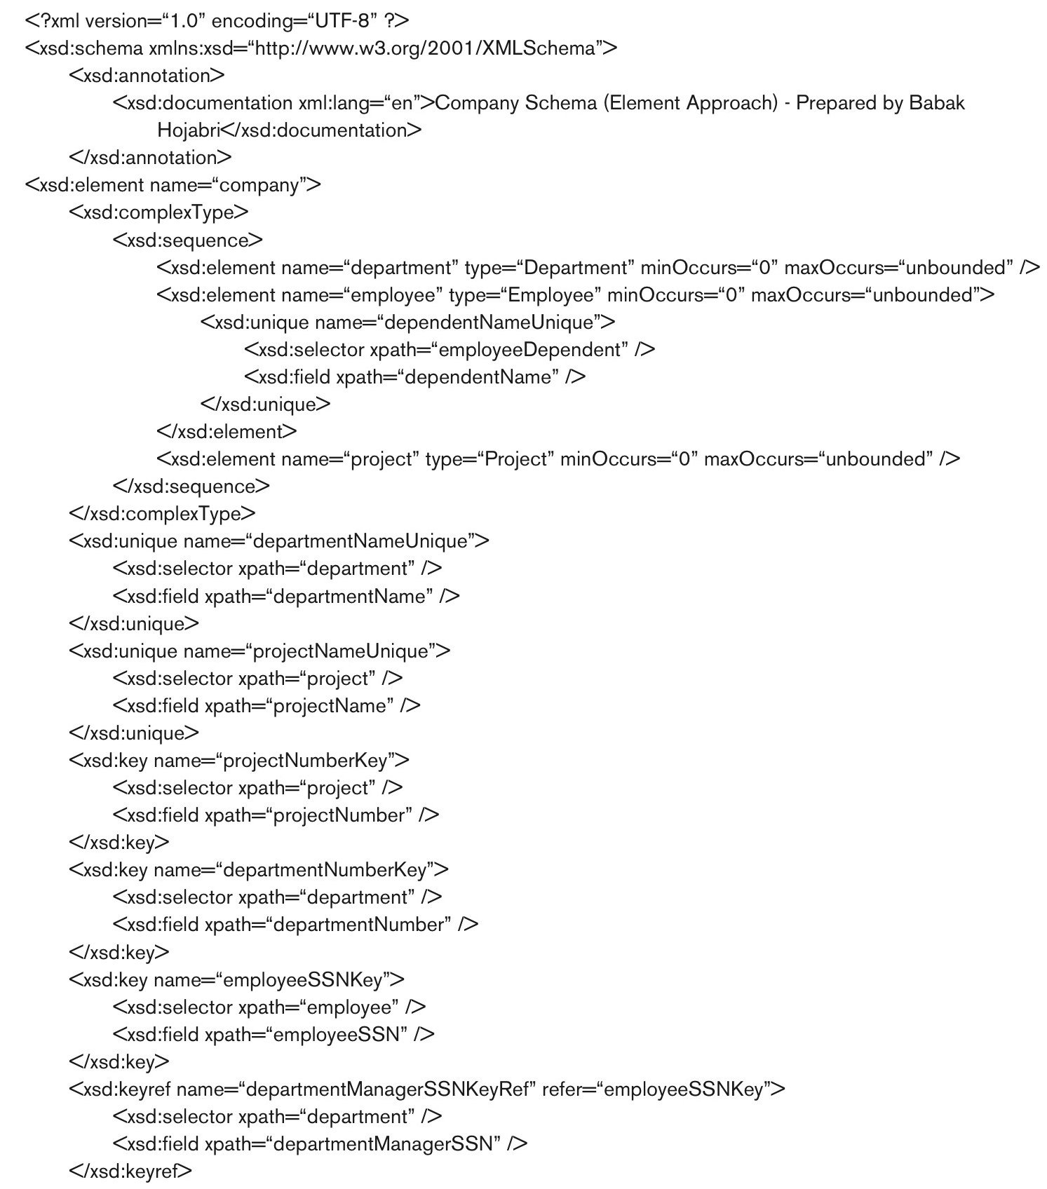
Figure 13.5 An XML schema file called company.
continued on next slide

Slide 20
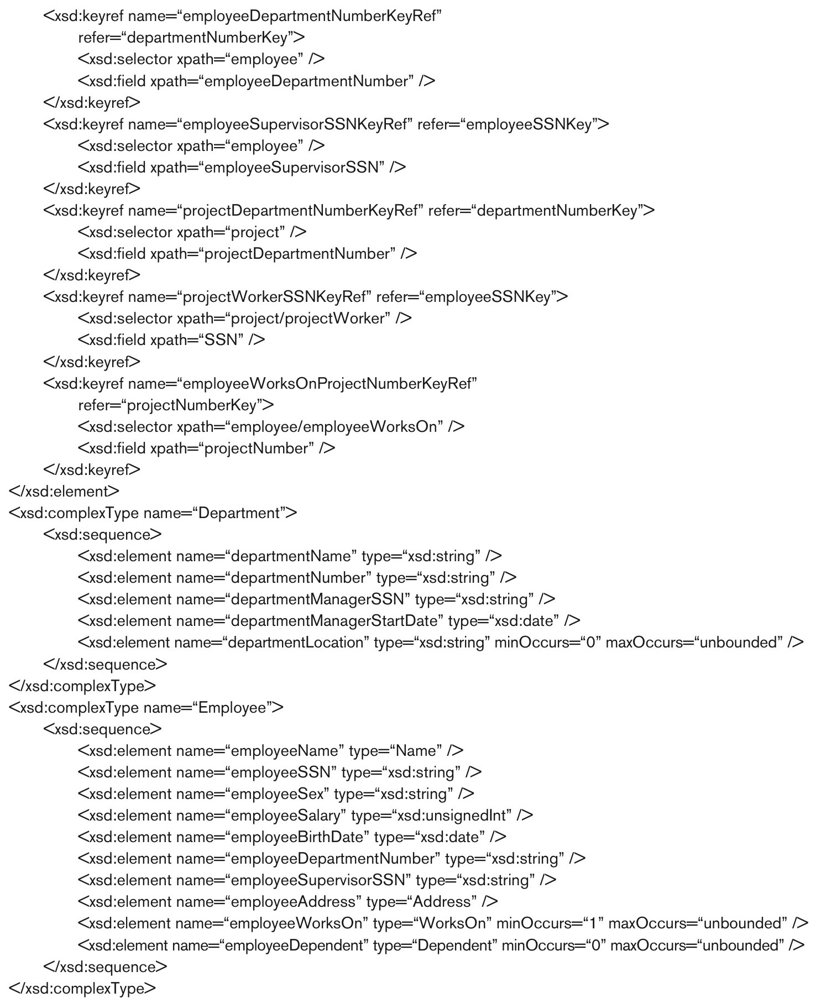
Figure 13.5 (continued) An XML schema file called company.
continued on next slide

Slide 21
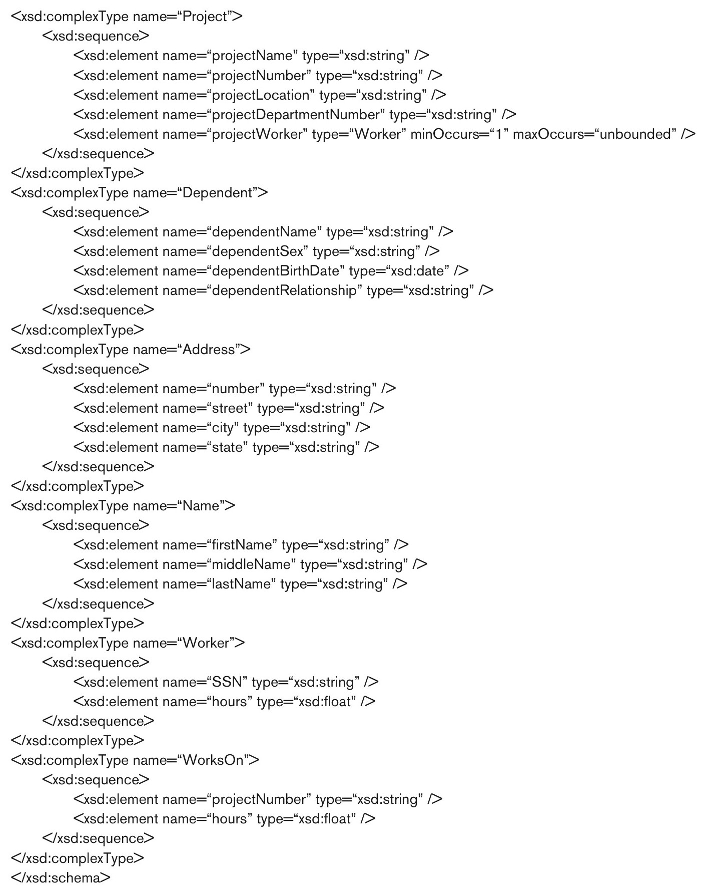
Figure 13.5 (continued) An XML schema file called company.

Slide 22
XPath
A way of querying an XML document
Allows you to pull data out on the fly as opposed to parsing it yourself
Specify a path using element names
Can add qualifier conditions as well
Will return the XML elements that meet the path and conditions
/ is a direct path, // is any path
Drawback
The path that specifies the pattern also specifies the data to retrieve
Makes more complicated queries difficult

Slide 23
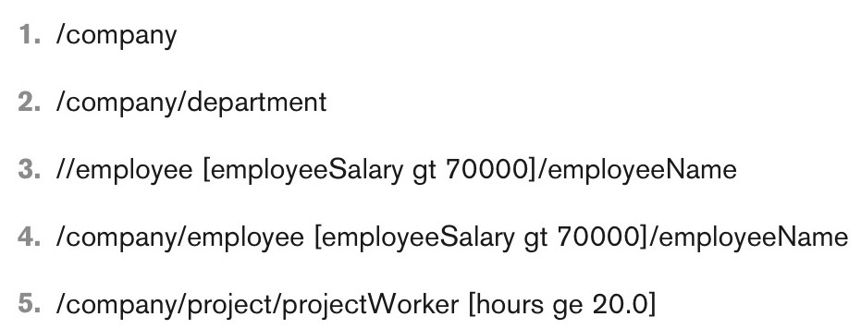
Figure 13.6 Some examples of XPath expressions on XML documents that follow the XML schema file company in Figure 13.5.

Slide 24
XQuery
More robust querying
FOR – variable bindings to individual elements/nodes
LET – variable binding for a collection of elements
WHERE – qualifier conditions
ORDER BY – order condition
RETURN – what data to include in the results

Slide 25
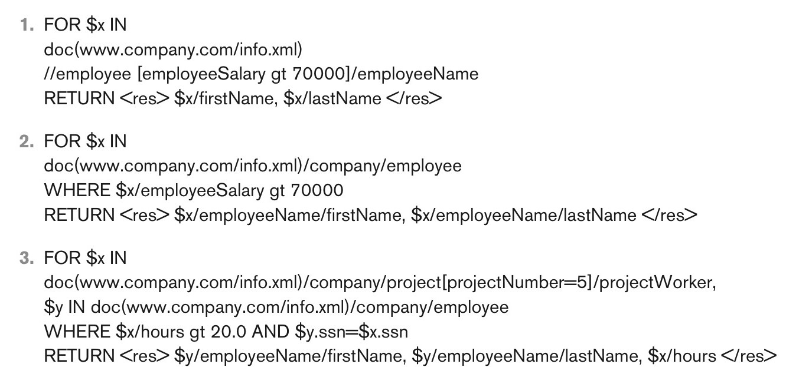
Figure 13.7 Some examples of XQuery queries on XML documents that follow the XML schema file company in Figure 13.5.

Slide 26
SQL and XML
SQL standards include syntax to have the results returned as XML instead of as a table
Some DBMSs allow this syntax
Use functions in the SELECT clause to specify the data should be returned as an XML ELEMENT
XMLELEMENT – specify a tag for the XML result
XMLFOREST – specify several tags at once
XMLAGG –group together xml elements to place under a parent tag
XMLROOT – specify the root tag
XMLATTRIBUTES – add attributes to an XML tag

Slide 27
SQL and XML
SELECT XMLROOT(
XMLELEMENT (NAME “dept4emps”,
XMLAGG(
XMLELEMENT(NAME “emp”,
XMLFOREST(Lname, Fname, Salary)
ORDER BY Lname)))
FROM Employee WHERE Dno = 4;
Returns
<dept4emps>
<emp>
<Lname> Jabbar </Lname>
<Fname>Ahmad</Fname>
<Salary>25000<\Salary>
</emp>
<emp>
<Lname>Wallace</Lname>
…
</dept4emps>

Slide 28
JSON
JavaScript Object Notation
Another syntax for storing and exchanging information
Like XML, self describing semi-structured data
Stored as text, so easy to transmit
Easy to convert back and forth between text and JavaScript Objects
You aren’t required to use JavaScript to use JSON, it just uses JavaScript Format
It has a lot of built in parsing functionality

Slide 29
Objects in JavaScript
JavaScript is much less structured that other C++ or Java
We don’t define classes, objects are self-describing
A collection of attributes
Syntax: Var <variable name> = {“<attribute name>”:<value>, “<attribute name>”:<value> …}
Get data back out:
<variable name>.<attribute name>
Set Data
<variable name>.<attribute name> = <new value>;
var myObj = { “name”:”John”, “age”:31, “city”:”New York”};

Slide 30
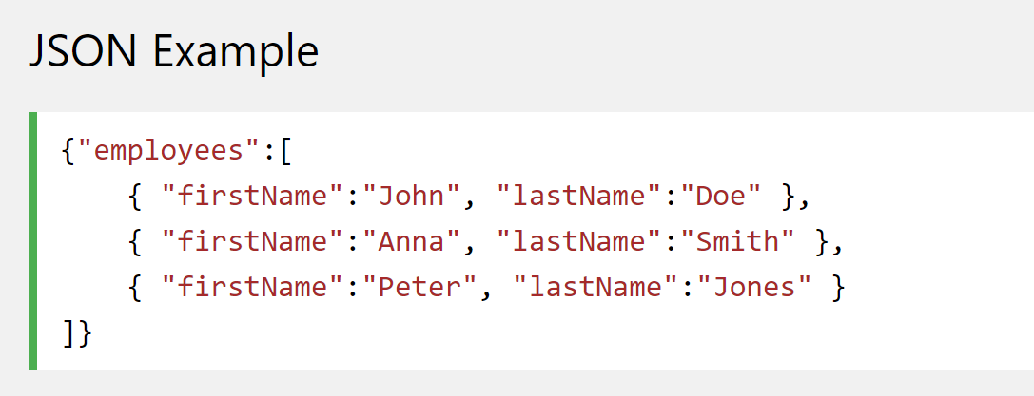
JSON
JSON borrows this notation to store data in text
Can also add collections of objects

Slide 31
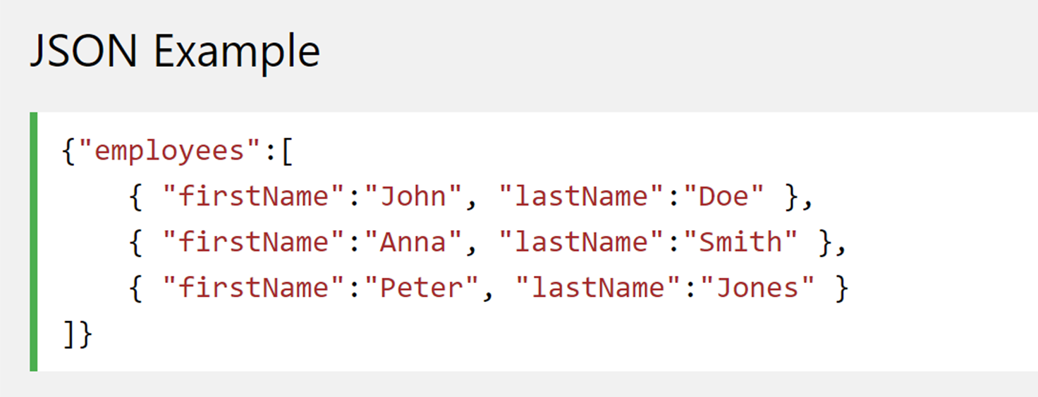
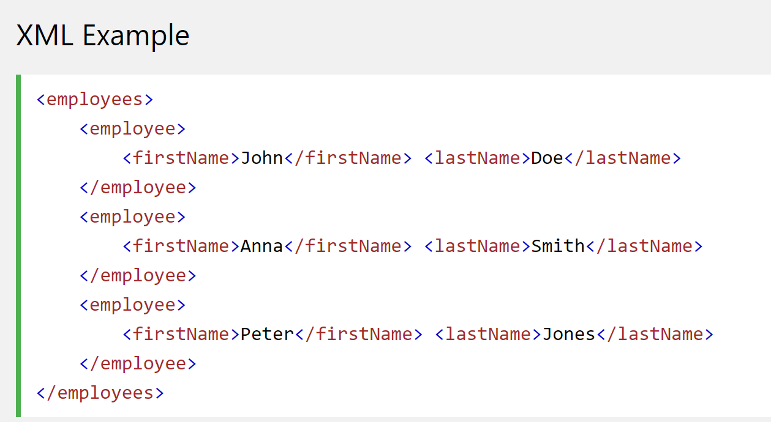
JSON vs XML

Slide 32
JSON vs XML
Similarities
Self Describing
Hierarchical
Able to be parsed
Easily transmitted
Differences
No End tag in JSON
JSON is shorter
Quicker to read and write
JSON can use arrays
JSON is easier to parse in JavaScript

Slide 33
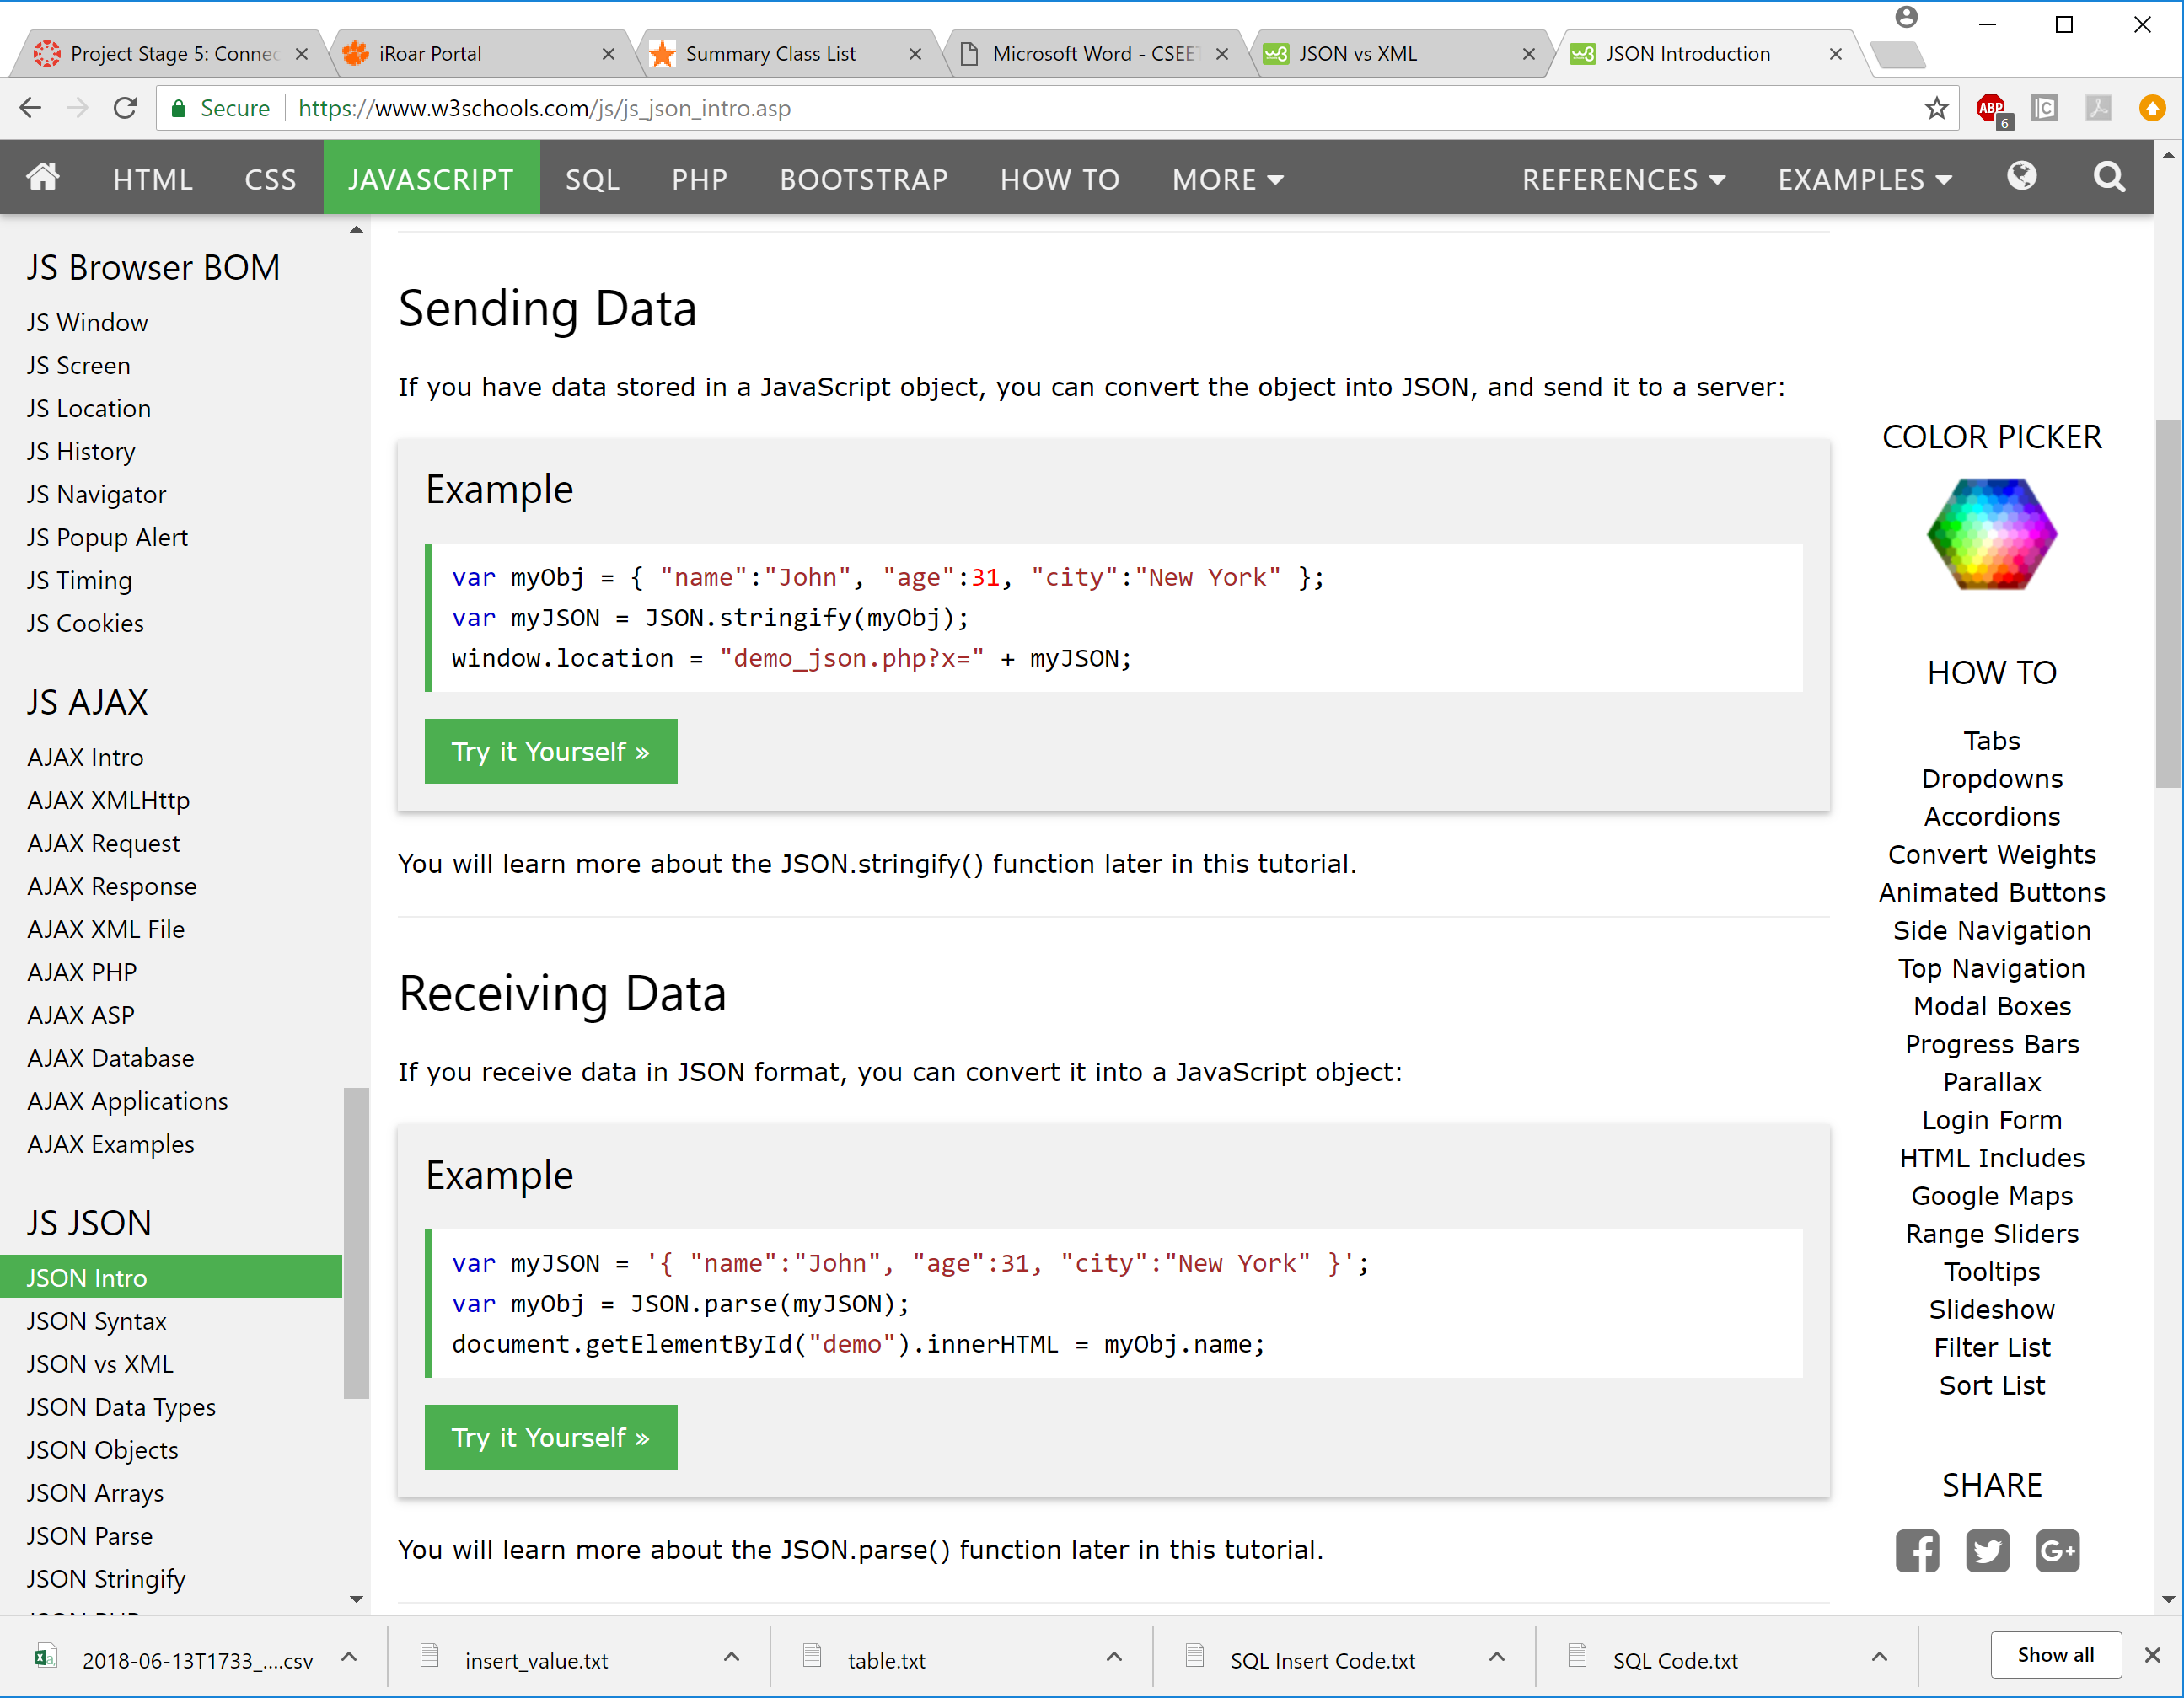
Parsing in JavaScript
Go from JavaScript Object to JSON text
Go from text to JavaScript Object

